Slide 1
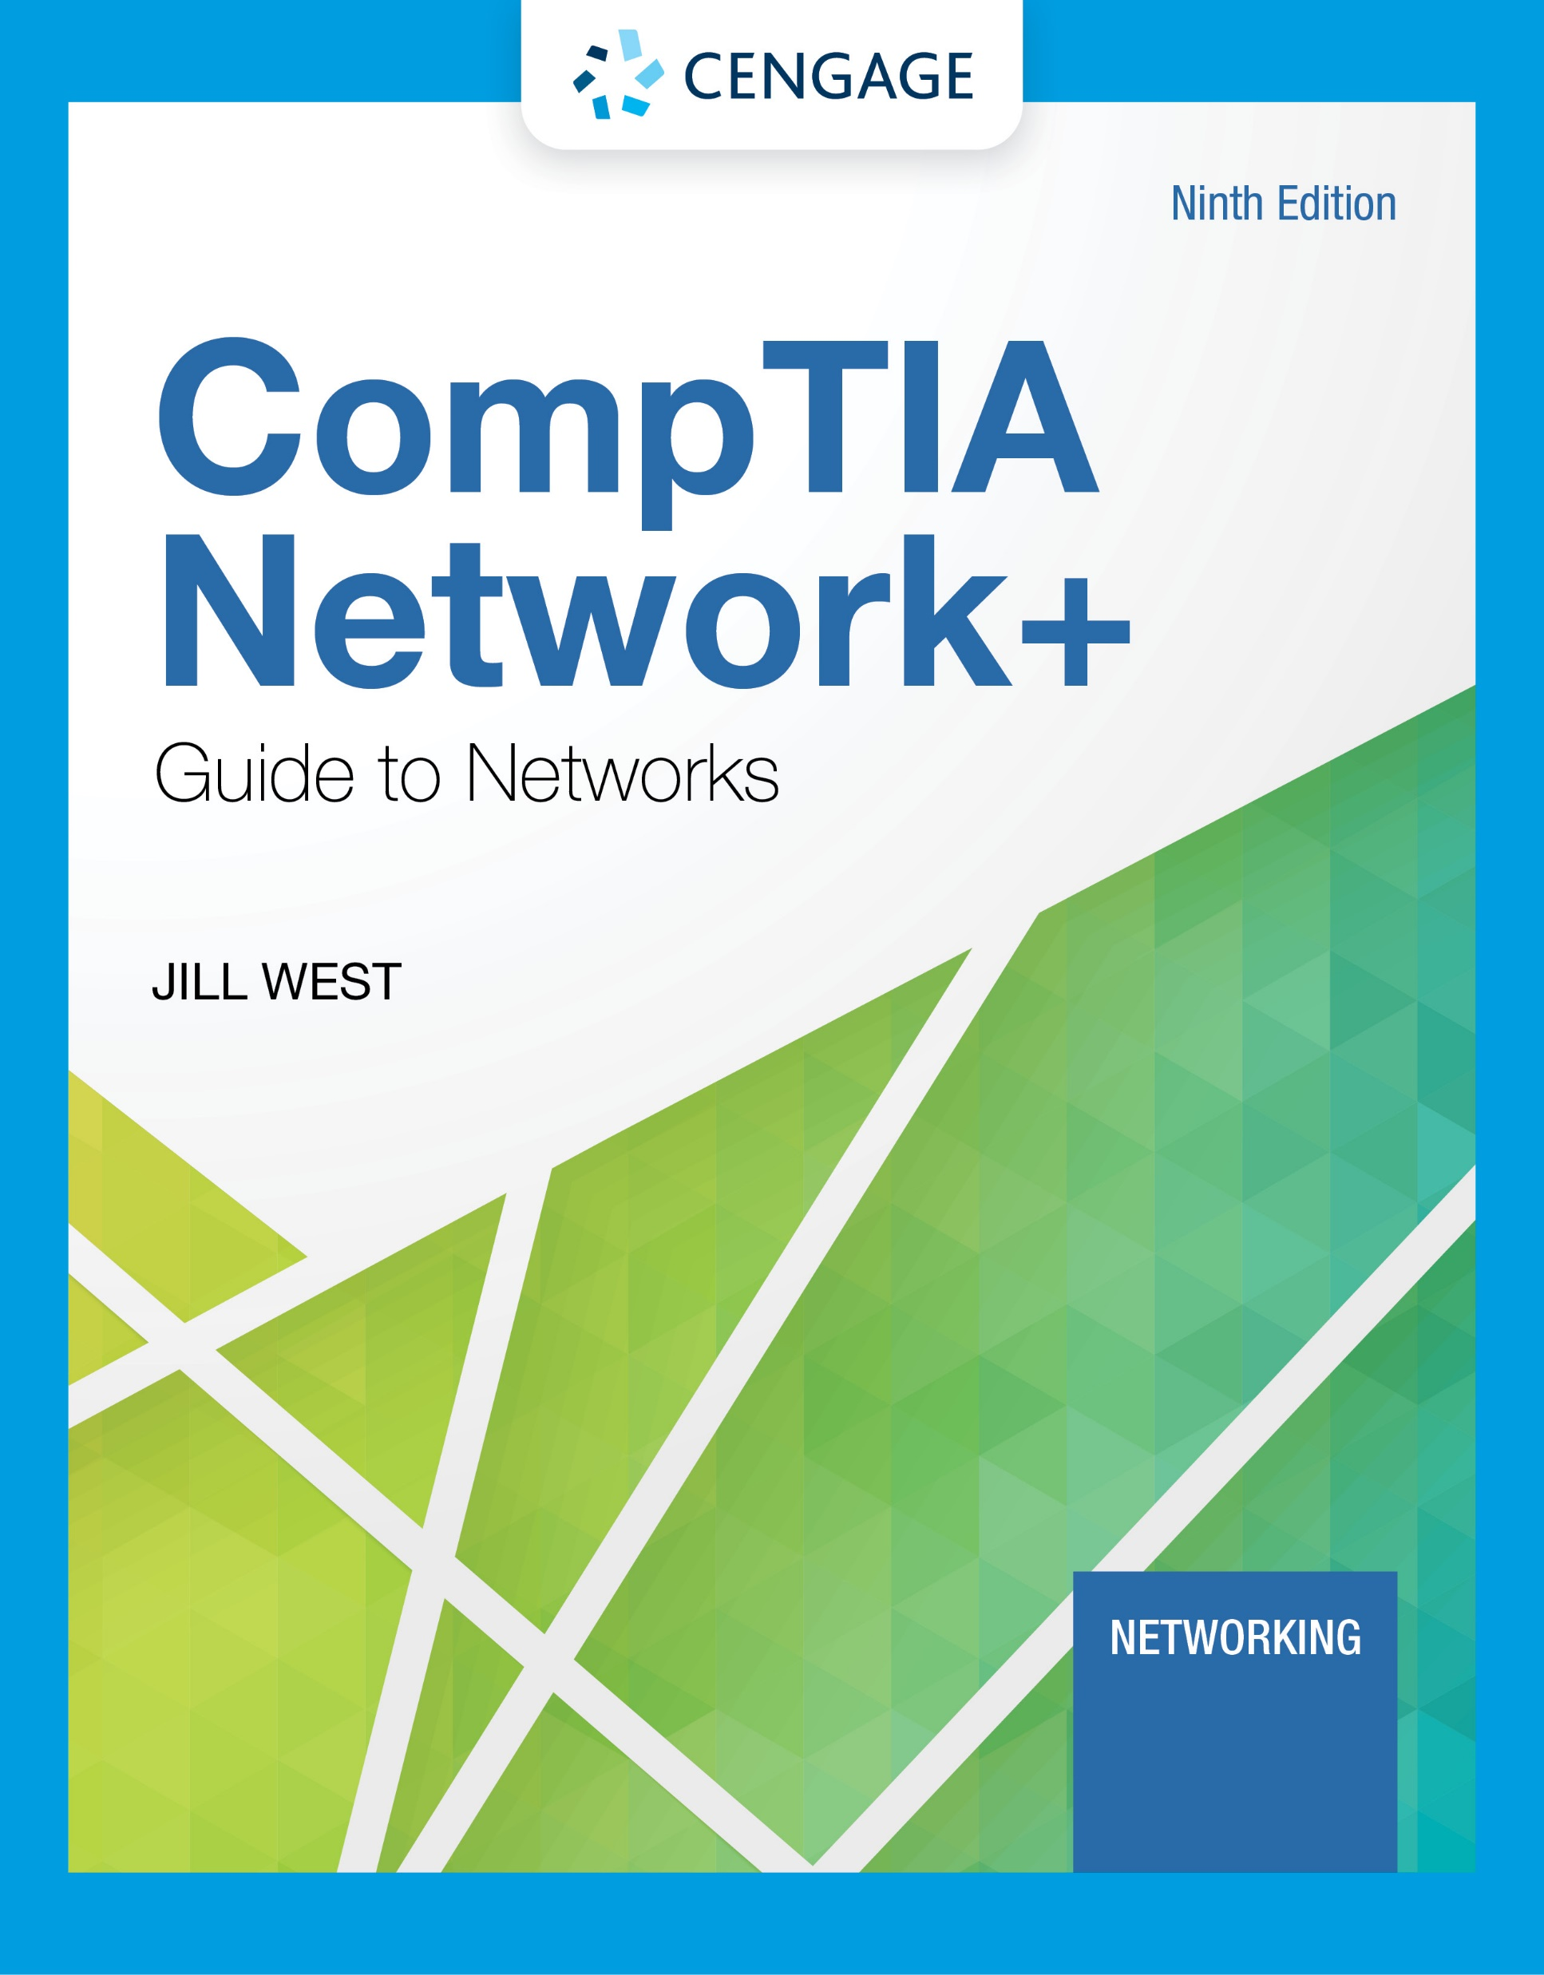
Module 7: Network Architecture
CompTIA Network+ Guide to Networks, Ninth Edition

Slide 2
Module Objectives
By the end of this module, you should be able to:
1. Explain types of abstraction in the design of physical network architecture
2. Describe and explain virtualization technologies on a network
3. Summarize cloud characteristics, models, and connectivity options
4. Identify methods to increase network availability

Slide 3
Module 8: Segmentation
CompTIA Network+ Guide to Networks, Ninth Edition

Slide 4
Module Objectives
By the end of this module, you should be able to:
1. Explain the purposes of network segmentation
2. Describe how subnetting works
3. Calculate subnets
4. Configure VLANs

Slide 5
Module 9: Wide Area Networking
CompTIA Network+ Guide to Networks, Ninth Edition

Slide 6
Module Objectives
By the end of this module, you should be able to:
1. Identify the fundamental elements of WAN service options
2. Explain how routers manage internetwork communications
3. Compare and contrast WAN connectivity technologies
4. Explain the most common wireless WAN technologies
5. Troubleshoot common connection problems

Slide 7
Module 10: Risk Management
CompTIA Network+ Guide to Networks, Ninth Edition

Slide 8
Module Objectives
By the end of this module, you should be able to:
1. Identify people, technology, and malware security risks to a network
2. Increase network security through risk assessment and management
3. Use physical security to prevent and detect intrusions
4. Implement device hardening techniques
5. Explain how security policies guide users’ activities on a network

Slide 9
Module 11: Security in Network Design
CompTIA Network+ Guide to Networks, Ninth Edition

Slide 10
Module Objectives
By the end of this module, you should be able to:
Incorporate security into the design of a network
Describe the functions and features of various network security devices
Explain how authentication, authorization, and accounting work together to help secure a network
Compare authentication technologies

Slide 11
Module 12: Performance and Recovery
CompTIA Network+ Guide to Networks, Ninth Edition

Slide 12
Module Objectives
By the end of this module, you should be able to:
Use appropriate tools to collect data about the network
Identify methods to optimize network performance
Identify best practices for incident response and disaster recovery

